Slide 1
Teaching with competencies
8 Multi-Level Workshops … Up to 10 or More Sessions
ALL 4 COMPETENCIES
Fran Brandow – AQIFGA 2015

Slide 2
Why Teach with Competencies?
The common element in every course in every level
Great for multi-level groups … shared information workshop with tiered activities
Directly linked to Ministry courses, outcomes and evaluations

Slide 3
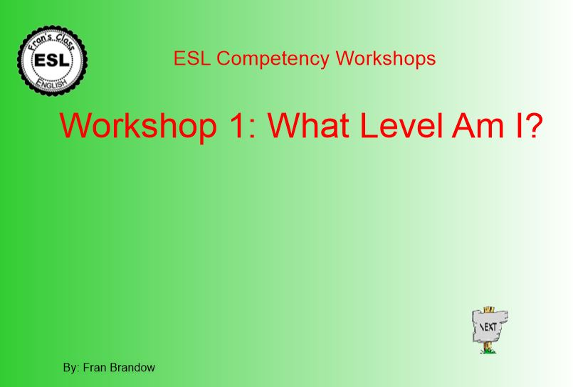
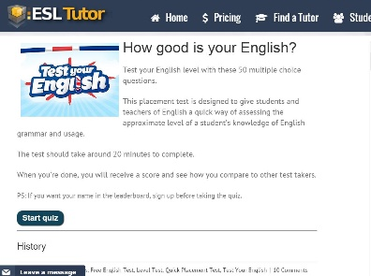
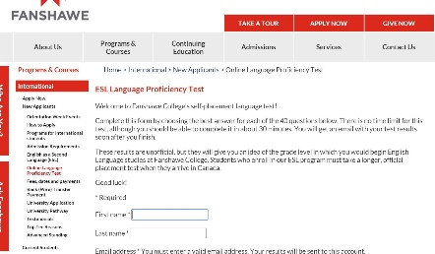
1: What level am I?
Make learners aware of national language standards
Use Canadian Language Benchmarks (basis for Renewal Programs) as a guide
Learners clearly see where they are now and where they are headed

Slide 4
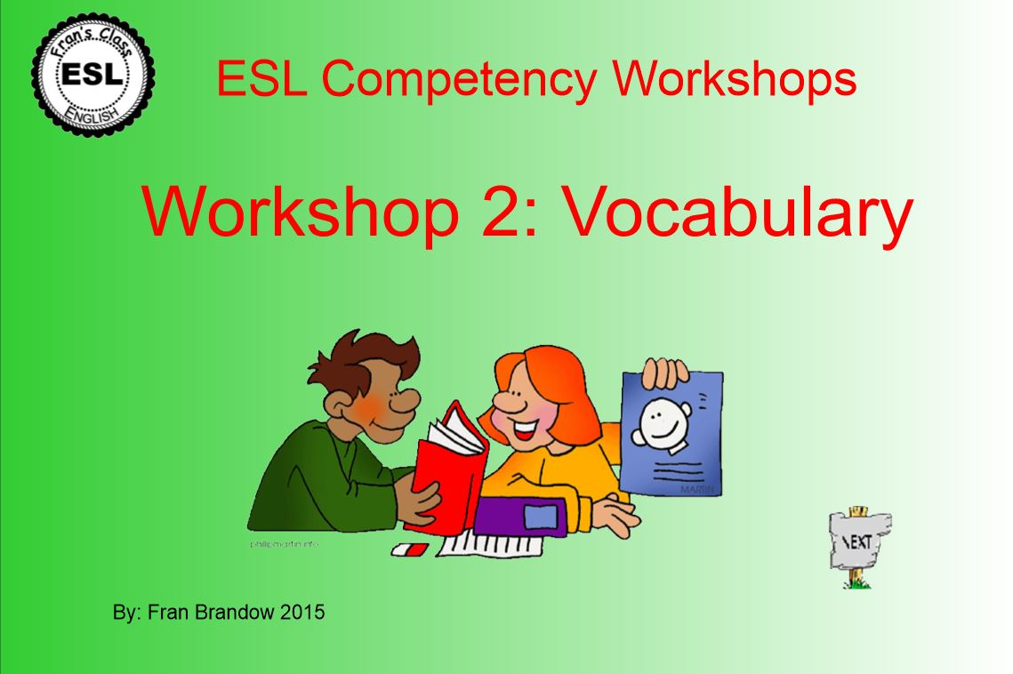
2: vocabulary
Expand vocabulary with solid skills
Learners feel more confident
Flipped Class: Experience progress with fun + proven online activities

Slide 5
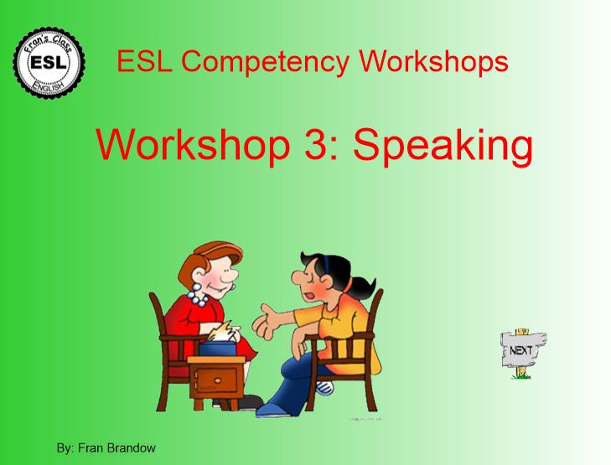
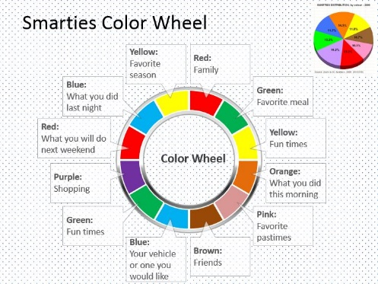
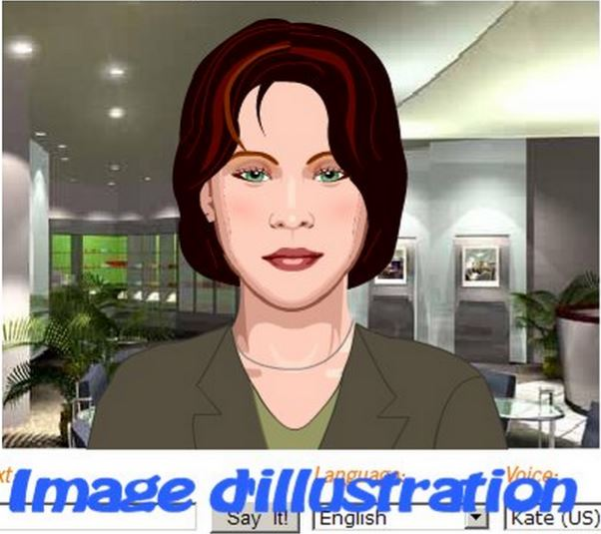
3: SPEAKING + Pronunciation
Concrete pronunciation aids
Build confidence using class activities
Develop speaking skills with proven techniques
Flipped Class: Pronunciation practices and online activities
Conversation-based and interaction activities
Audrey Type + Speak

Slide 6
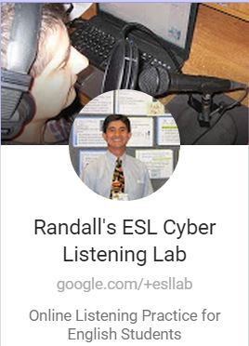
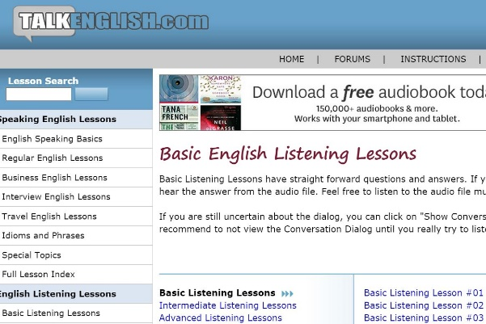
4: Listening
Techniques to improve listening skills
Practical guides for listening, understanding and interacting
Flipped Class: Multilevel listening sites with comprehension exercises
General and specific listening sites

Slide 7
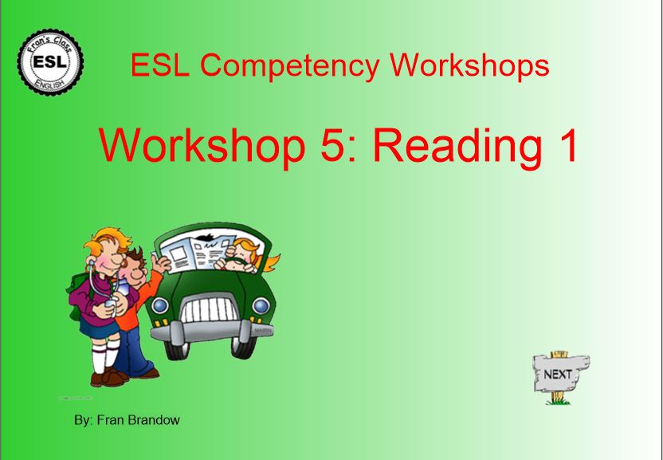
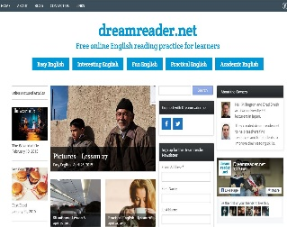
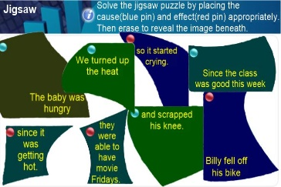
5: reading 1
Hold an Experimental Reading Workshop
Teach well-known reading strategies
Flipped class: Online reading sites with activities for multiple levels
Learners use strategies with Reading Resources
Targeted reading activities

Slide 8
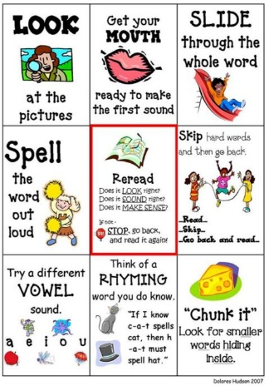
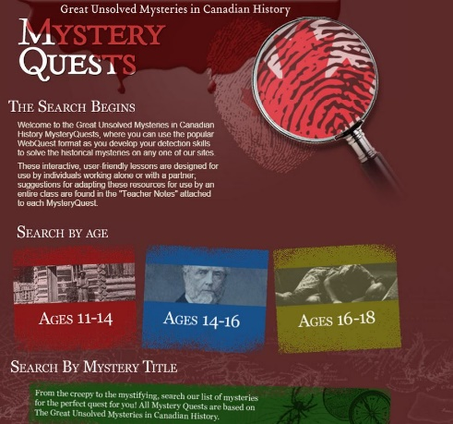
6: Reading 2
READING CHALLENGES Strategies for Author’s Purpose and Global Understanding
Flipped Class: Word decoding: phonics, sounding, rhyming …
Great sites to encourage reluctant readers

Slide 9
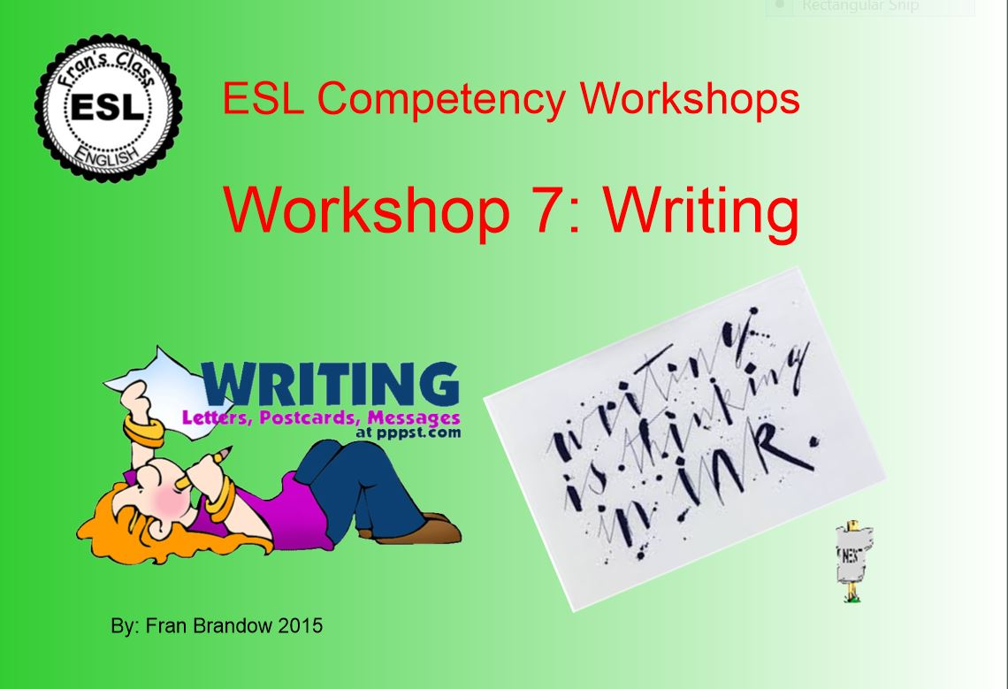
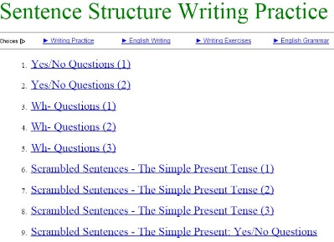
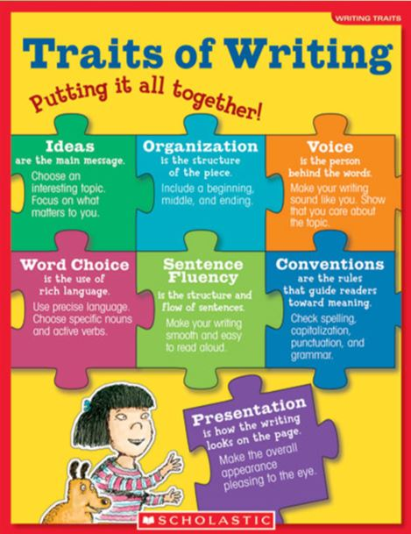
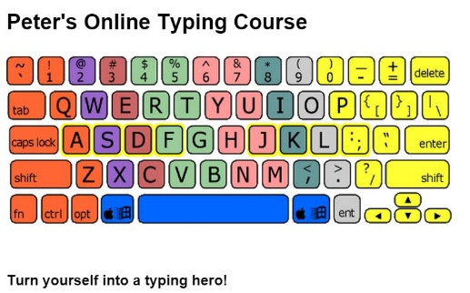
7: wRITING
Organize writing from prewriting through the steps of the writing process
Introduce: how to revise and edit writing, how to type
Flipped Class: scrambled sentences, dictations
Writing to online robots or other learners

Slide 10
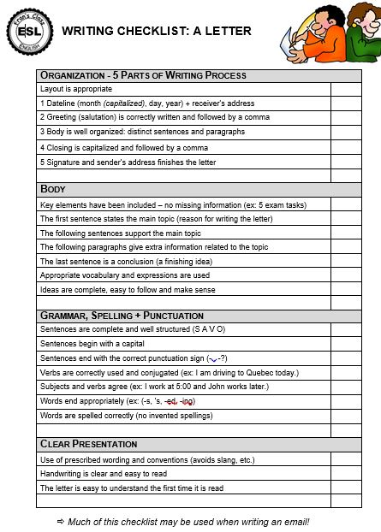
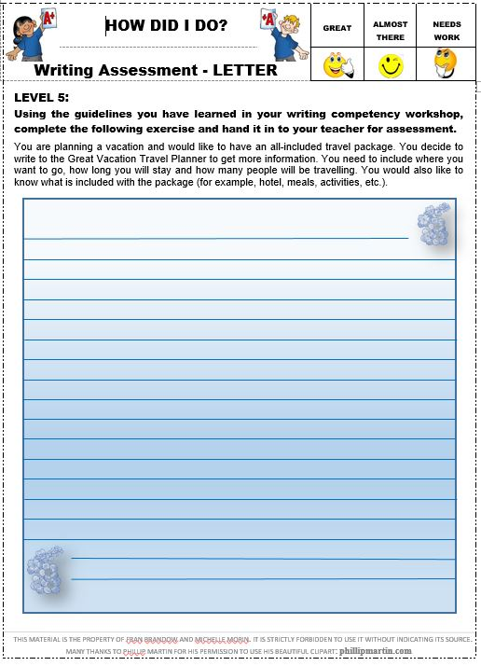
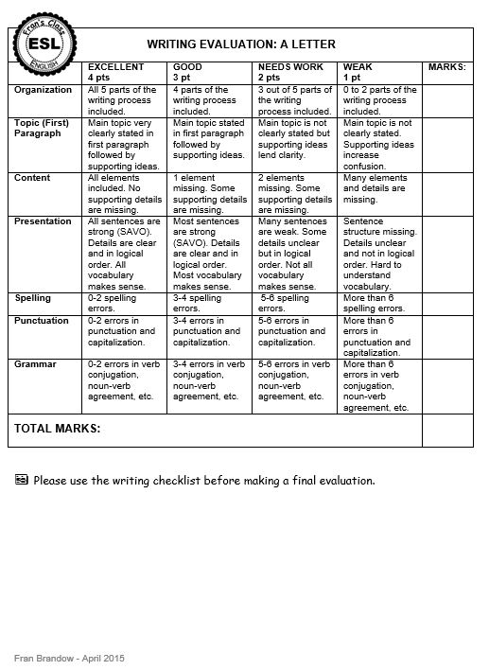
8: Writing Workshops
Writing PowerPoints: Forms, Notes, Postcards, Letters
Checklists for writing a note, a postcard and a letter
Practices and Assessments for various writing practices

Slide 11
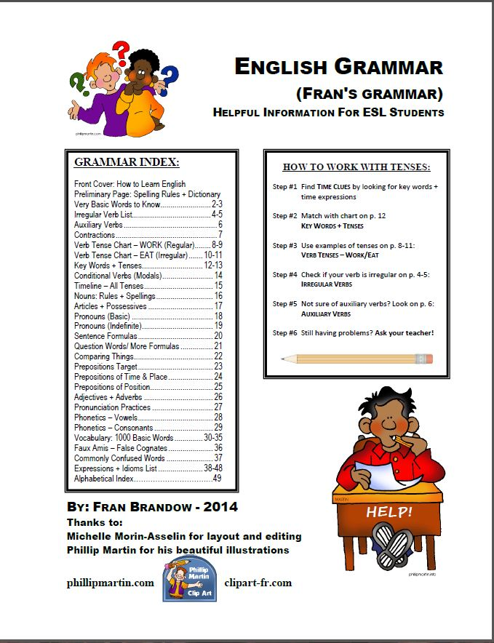
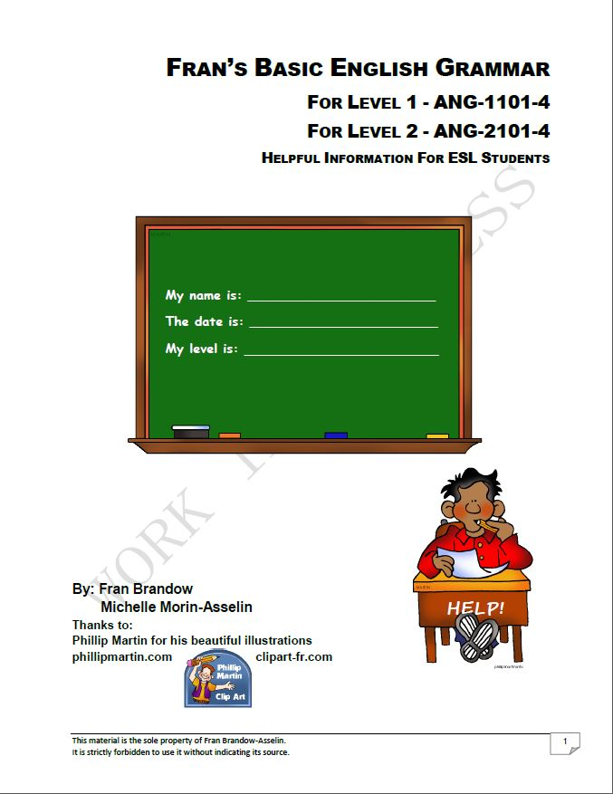
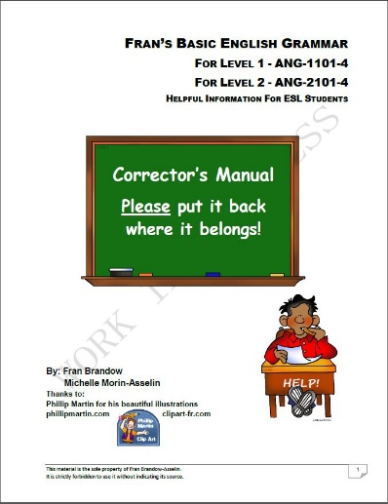
Fran’s Books
AVAILABLE FREE ON FRAN’S ENGLISH CLASS BLOG
Language tools for ESL Learners
Coming 2016: FRAN’S ENGLISH CLASS JOURNALS for Levels 1 - 3

Slide 12
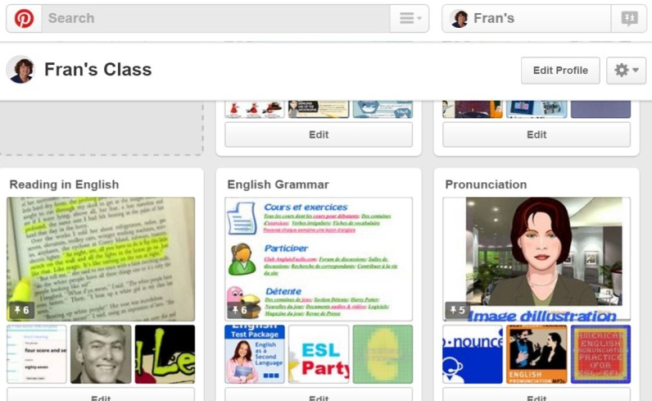
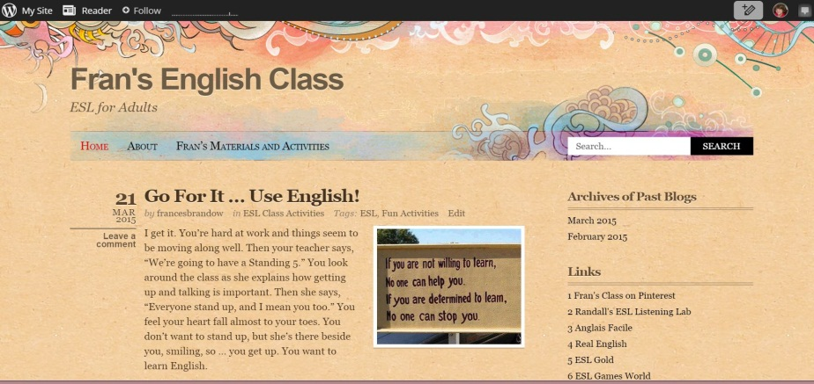
Would You Like to Connect to Fran’s Class?
Fran’s English Class Blog … Interesting articles about our class and activities, new discoveries for learning English and ideas to think about
Fran’s Class On Pinterest … Great boards with ‘Pins’ for learning and idea development
Coming Soon … English@CSBE – Find us at: http://english.ticfga.ca/

Slide 13
Questions? Contact Fran: frances.brandow@csbe.qc.ca
Yes … your class CAN go from this to that with the ideas in this Workshop …
HAVE FUN!

